Slide 1

































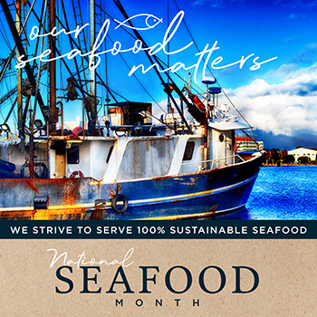







MetLife aurora
  Monday – Friday
Breakfast: 7:30 am – 9:30 am
Lunch: 11:30 am – 1:30 pm
WEEK Of July 28th
Rise & Shine
breakfast
      breakfast burrito 5.20 one egg or egg white 1.70
      omelet 5.00 2 egg scrambler/toppings 3.55 breakfast sandwiches bacon 1.10
      egg, cheese and meat 4.85 sausage 1.25
      egg and cheese 4.10 breakfast potato 2.10
    oatmeal 2.00
    yogurt parfait bar
    toasted coconut, granola, fresh fruit and craisin
    .49 per oz
    TUE-WED
    Chorizo and egg burrito with crispy hashbrowns
    6.30
flame
      burger, turkey burger, veggie burger, beyond burger, grilled chicken, crispy chicken 6.40-7.25
      chicken tenders 5.20
      Bacon mushroom Swiss burger – toasted brioche, smoked bacon, sauteed mushrooms and Swiss cheese 7.15
      MADE TO ORDER SANDWICHES & WRAPS-
      turkey, ham, egg, chicken or tuna salad w/ assorted cheeses & breads 5.90
      Midwest Turkey Club – Smoked turkey, bacon, provolone, lettuce, tomato and chipotle mayo 6.10
B+b
MON-THURS Cauliflower bisque 3.25
      salad bar carrots, cucumber, green onion, hard boiled eggs, tomatoes, beans, olives, a variety of lettuce blends, cheeses and a composed salad .49 oz
Soup Salad
entree
TUESDAY
Pizza by the Slice – Pepperoni, Sausage, veggie or 4 cheese 3.49
WEDNESDAY
Pizza by the Slice – Pepperoni, Sausage, veggie or 4 cheese 3.49
entree
salads
sandwiches
and more…
      chef manager – eric.mcbride@compass-usa.com
      catering – metlife-aurora.catertrax.com
      eurestcafes.compass-usa.com/MetLife

